Slide 1
Charts and Graphs
EDC&I 583
Message Design
8 February 2012

Slide 2
This Evening’s Agenda
Debrief on Superbowl Ads: Design elements
Good and Bad examples
Presentation: Charts and Graphs
Sidebar: Economist magazine (“newspaper”)
Sidebar: The XKCD Money chart (cf. paper & online)
Discuss Tufte, Williams, articles
Re-design Presentations
A quick tour through journals, associations, etc.

Slide 3
First… Word Clouds and Review of Doc Student Applications

Slide 4
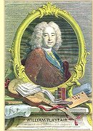
Charts and Graphs
Somebody had to invent all this stuff…
William Playfair (1759 –1823)
Scottish engineer and political economist
Bar graph and pie chart (uh oh…)

Slide 5
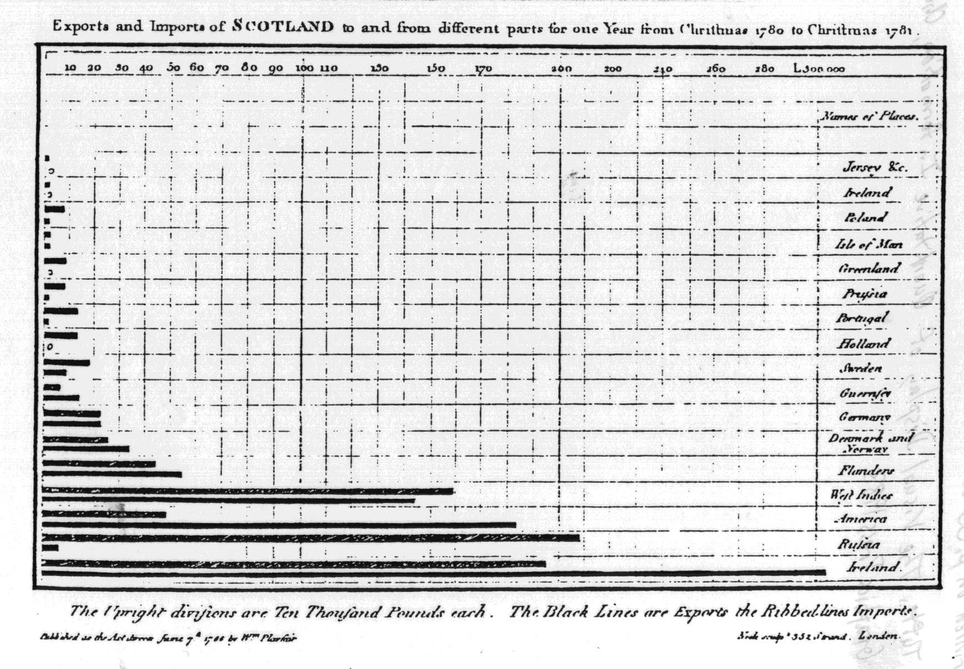
Bar Chart – by Playfair
Exports and imports of Scotland, 1786
One of the first to use this format
Two data-points per year
X-axis as quantity rather than time was a novelty

Slide 6
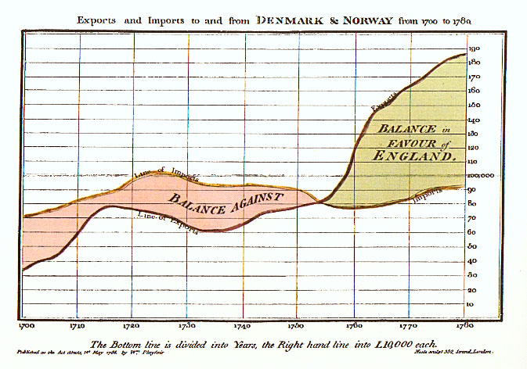
Line Graph – by Playfair
Trade balance time series sequence
Commercial and Political Atlas, 1786
Imports/exports, Denmark/Norway to/from England
1700-1780

Slide 7
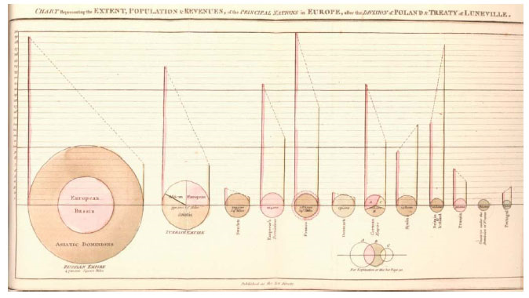
Pie Chart – by Playfair
Statistical Breviary, 1801
Early pie chart (or mix of pie and bar); variables:
land mass empires (pie charts)
relative population (graphs)
relative revenues (graphs)
maritime powers (color)
relative tax burden on their population (graphs)

Slide 8
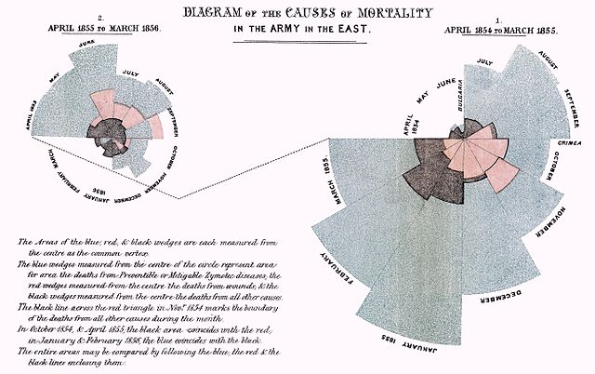
A Variant: Polar Area Diagram
Used famously by Florence Nightingale to represent Crimean War deaths (1855)
To plot cyclic phenomena (e.g., count of deaths by month)
If death count in each month is subdivided by cause of death, once can make multiple comparisons on one diagram
Today sometimes “Circular histogram”

Slide 9
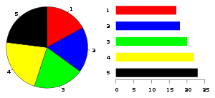
Pie Problems
People have more trouble estimating quantity by angle or area than by line length
With which of these do you get a more accurate reading? ⇒

Slide 10
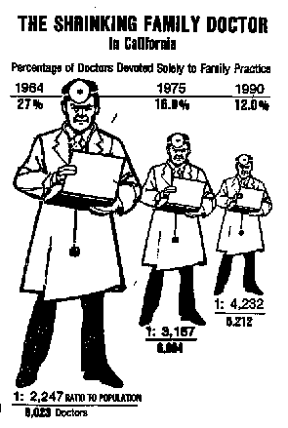
Charts, Graphs, and Statistical Distortion
Tufte’s “amazing shrinking doctor”
Only the height of the figure is relevant
But the natural reaction is to read both height and area as important
If big doc = 8 ft., and small doc = 4 ft
Small doc weights 100 lbs, big doc weighs??
(more than 200 lbs!)

Slide 11
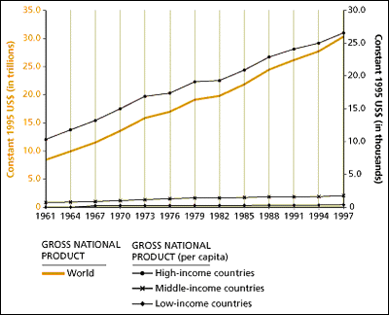
Another Distortion
From The State of the World’s Children, 2000
“growing [income] gap between rich and poor countries”
High-income countries clearly increased from ≈ $12 K to ≈ $26 K
But what happened to poor or middle countries?
Scale doesn’t allow us to tell

Slide 12
Tufte’s “Data to Ink Ratio”
The ink used to “frame” the graphic (axes, labels, shading, etc.” should be less dominant than the ink used to represent the actual data

Slide 13
Chartjunk
Takes focus away from the data

Slide 14
Tuftean Bugbear: The “Duck”
Any chart or graph that contains “self-promoting” decoration, ornament, etc.
Specific possibilities: color, fake 3-D effects, random patterns and textures, and so on.

Slide 15
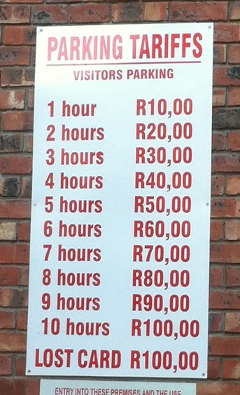
Data to Ink - Redundancy
Should we really assume that people can’t do basic math?
(i.e., wouldn’t “R10 per hour” suffice?)

Slide 16
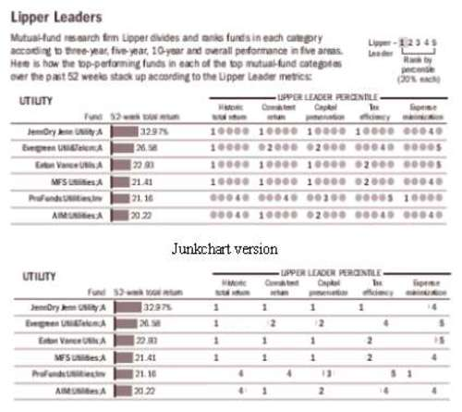
Junk Chart to Simpler Chart
Do those extra grey circles add anything?
Improved version

Slide 17
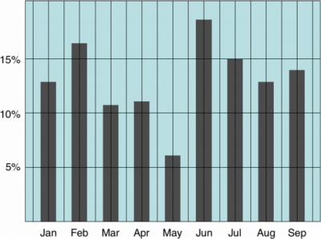
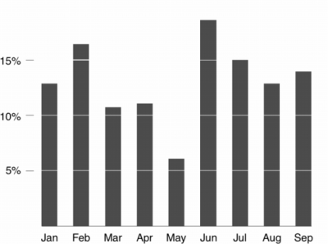
Line Graphs
Example of the “Data to Ink Ratio” in action
The ink used to “frame” the graphic (axes, labels, shading, etc.” should be less dominant than the ink used to represent the actual data
Delete border, background color, grid lines
Focus attention on horizontal scales (“the ‘data ink’”)
Low data/ink ratio (bad)↓
High data/ink ratio (good)↓

Slide 18
But…
Studies show that many people (students) don’t like Tufte’s minimalist approach
They’d rather have “chartjunk”!
Are they reflecting what they’ve been exposed to, how they’ve been taught, or is Tufte wrong?

Slide 19
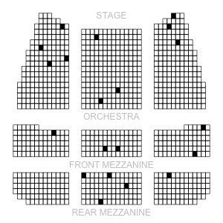
A Counter-Example (“Why People Like Chartjunk”?)
“Risk Characterization Theater”
How to show risks in a population
Here, 2% risk (20 cases out of 1000)
Tufte wouldn’t like – low data/ink ratio

Slide 20
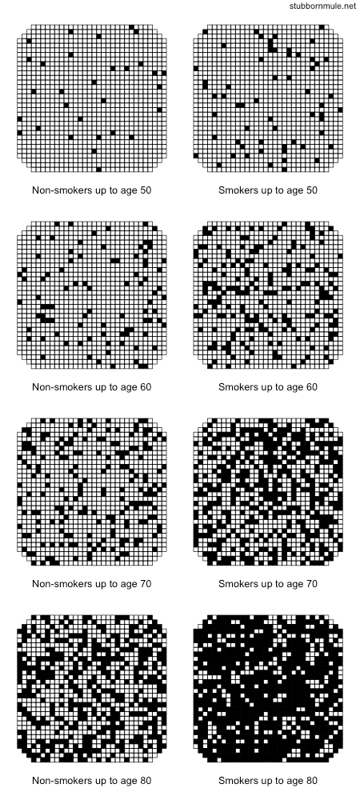
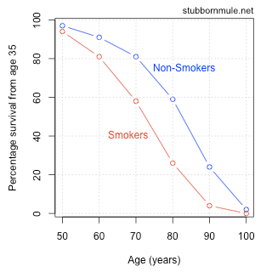
Or Showing Risk over Time
Survival of doctors born between 1900 and 1930
Smokers and non-smokers
Cf.: Original graph:

Slide 21
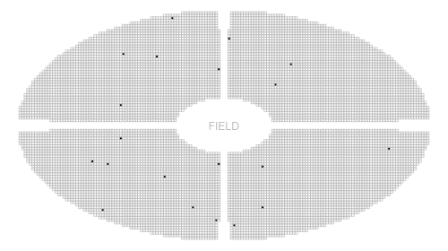
More Risk Visualization
The “risk characterization stadium”
For 2% risk out of a population of 10,000
(20 cases)

Slide 22
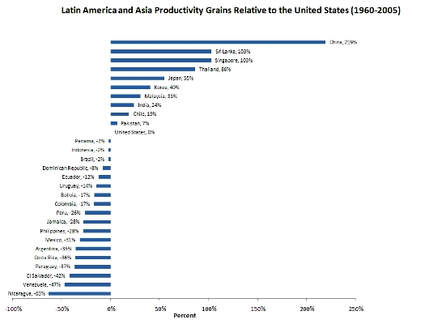
Interpreting Graphs

Slide 23
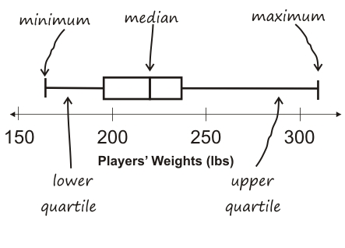
Variations on Bar Charts
Box-and-whisker plot

Slide 24
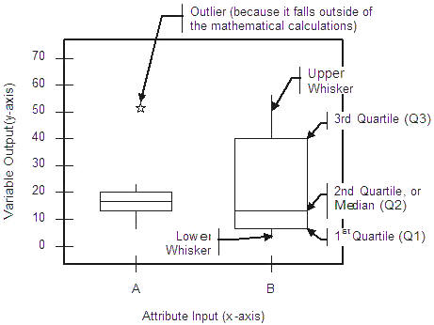
Dealing with Outliers
“Seems like this one is an anomaly…”

Slide 25
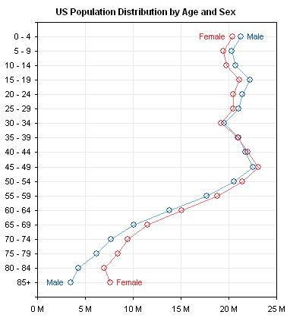
Other Graph-Like Representations
Dot plot

Slide 26
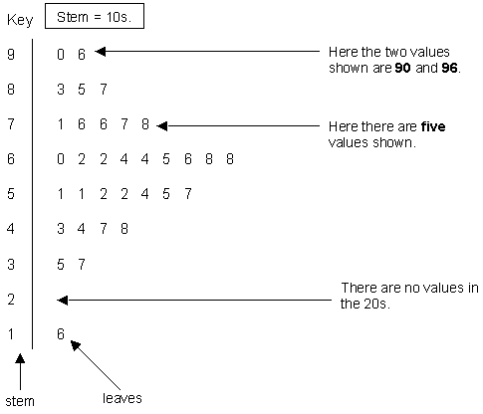
Stem-and-Leaf Plot
Good for showing distributions

Slide 27
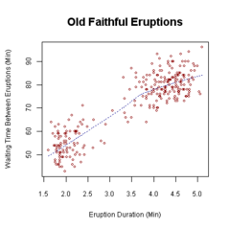
Scatter Plot
Patterns underlying distributions show up well

Slide 28
Questions for Discussion
Tufte: “Calming the grid down” – are you a minimalist or a chart-junkist? What does chart junk add?
Interpret the Latin America and Asia Productivity Gains graph; come up with a one-sentence description of what it conveys
If we were to reinvent the isotype symbols today, what would we want to include? (And how would the approach look different from how it looked in the 1920s?)

